Slide 1
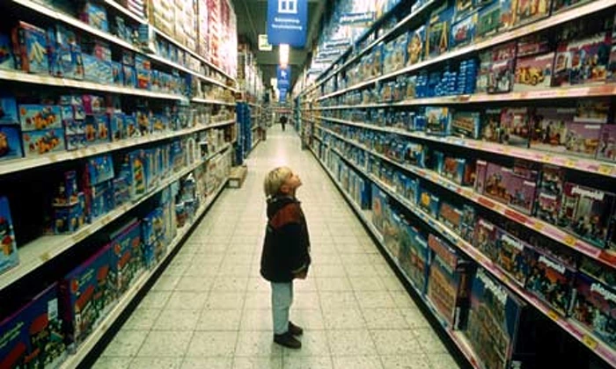

APO 15th Anniversary
Evidence based policy: Why is progress so slow and what can be done about it?
28th Nov, 2017
Nicholas Gruen
E ngruen@lateraleconomics.com.au
Notes:
Embedding evidence-based policy into program design and service delivery
Questions You've previously talked about building the public goods of the 21st century. How does this work relate to that agenda?
You wrote in a recent article in the Mandarin that strategy in organisations should be seen as closely related to ethical practice. Could you elaborate on that and its relevance to what you’ve spoken about today.
Design: From fad to foundation, from infancy to maturity, from services to policy
Outline: Design has made its way into the delivery of government via the design thinking fad. It’s one of the most powerful means by which we can respond to both the growing complexity of the world (though it was never all that simple!) and to the need to elicit the agency of citizens in government programs. But design has always been a counter-narrative – a discipline of cross-disciplinarity – and has made negligible progress in influencing the systems of which it is a crucial part.
This presentation will explore service design in government (including co-design), where we’ve come, what’s holding back policy and strategies for progress.

Slide 2

Outline
Introduction
Arteries and capillaries
Thick and thin problems
Evidence based programs
Evaluation
Program logic
Accountability
Institutionalising evidence-based policy

Slide 3
1 Introduction

Slide 4
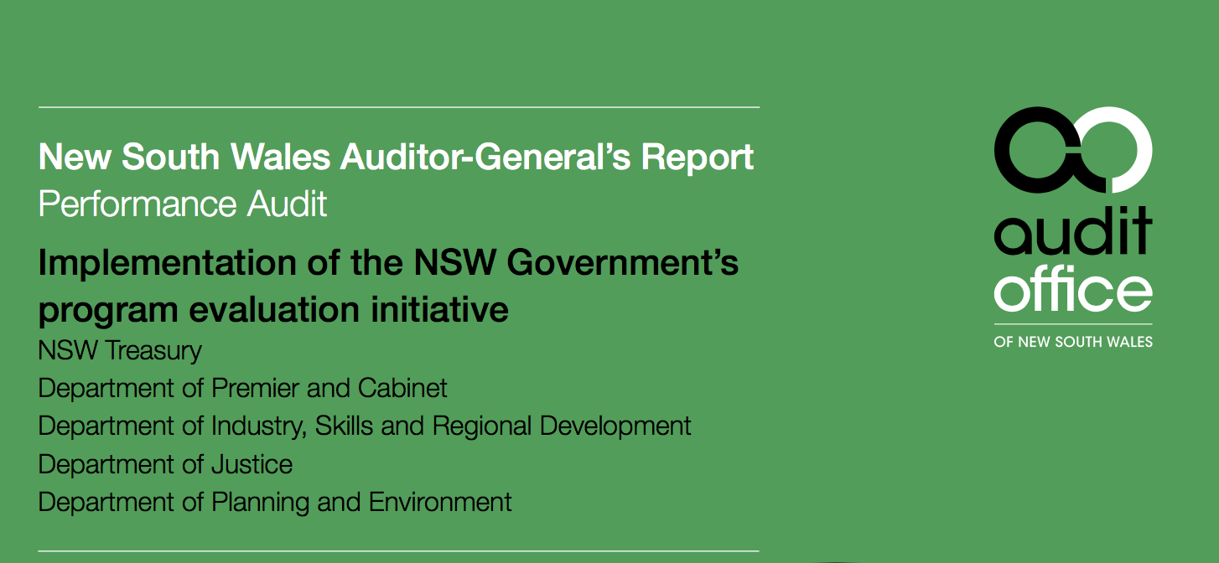
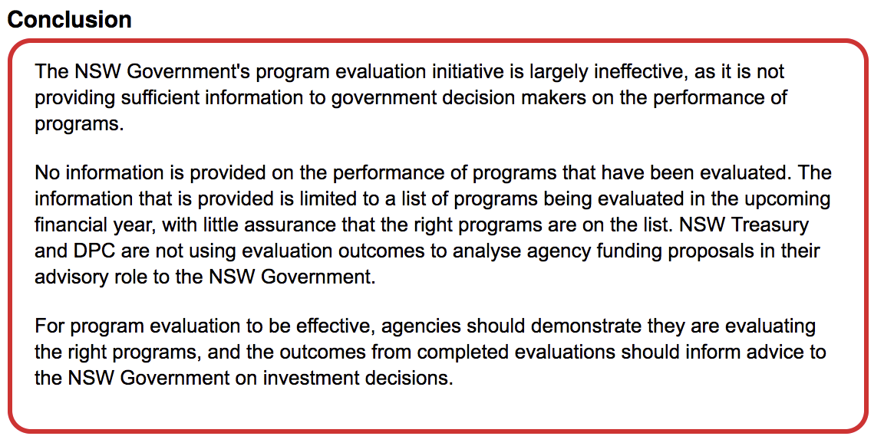
Evidence-based policy
Notes:
http://www.audit.nsw.gov.au/publications/latest-reports/performance/implementation-of-the-nsw-government-s-program-evaluation-initiative/executive-summary/1-executive-summary

Slide 5
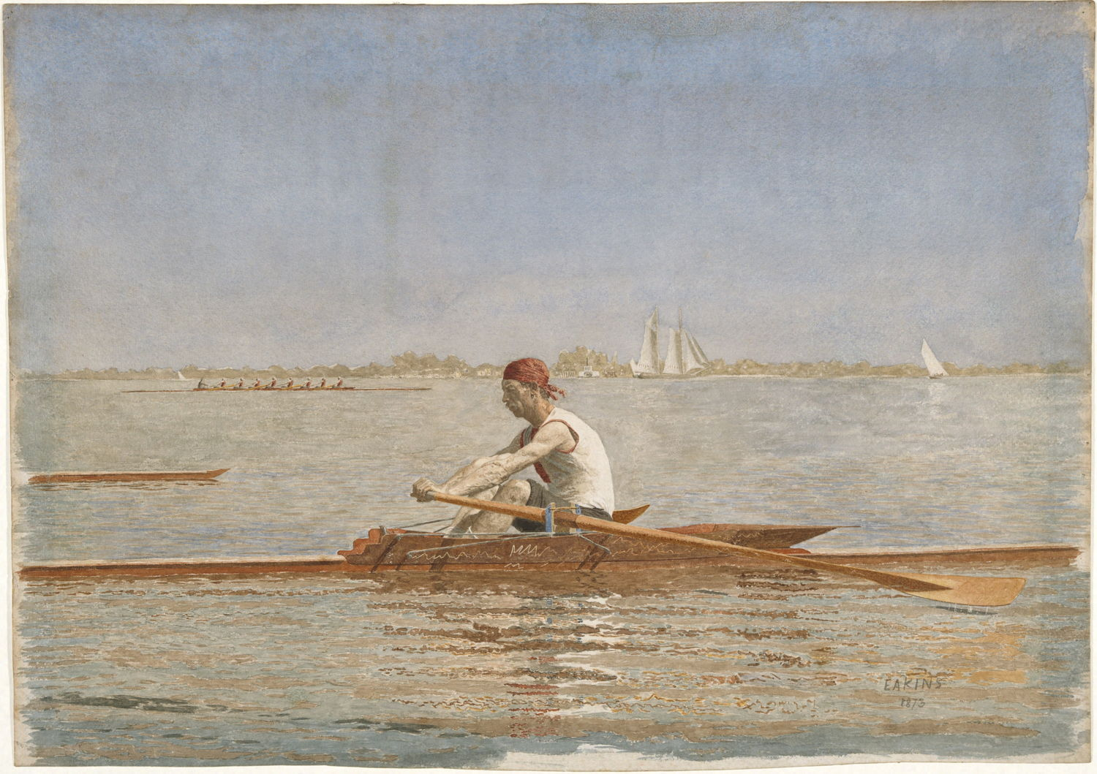
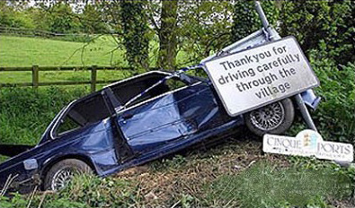
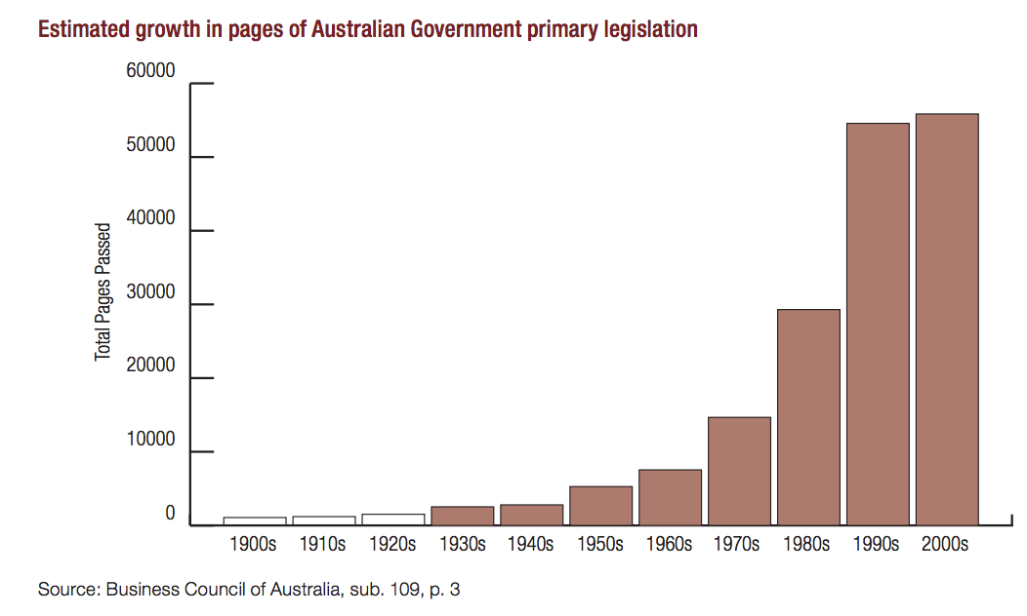

Slide 6
2 Arteries and capillaries

Slide 7
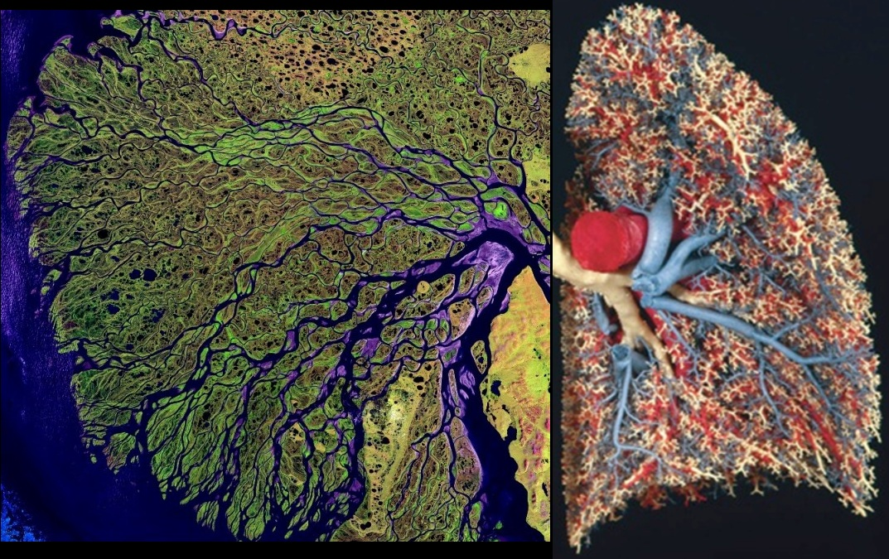

Slide 8


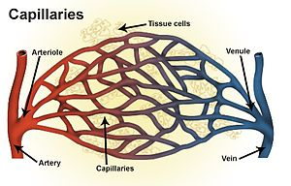

Slide 9
The human world is …
A hierarchy of trunks and branches
Arteries and capillaries

Slide 10
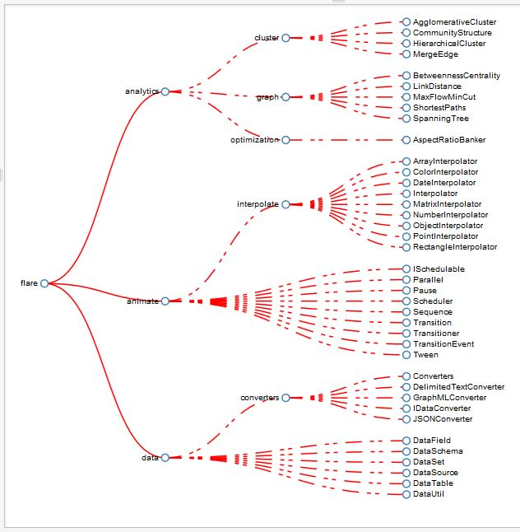
This could be a
Software program
Profession or discipline
Industry
Encyclopedia
Catalogue
Org chart
Corporate accounts
Corporate KPIs

Slide 11
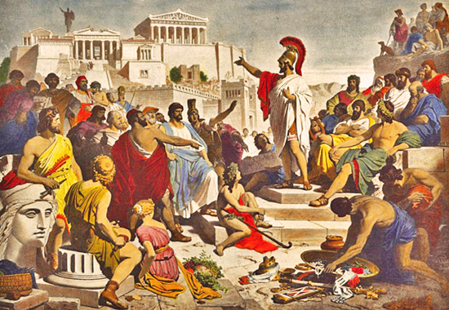
Democracies are hierarchies

Slide 12
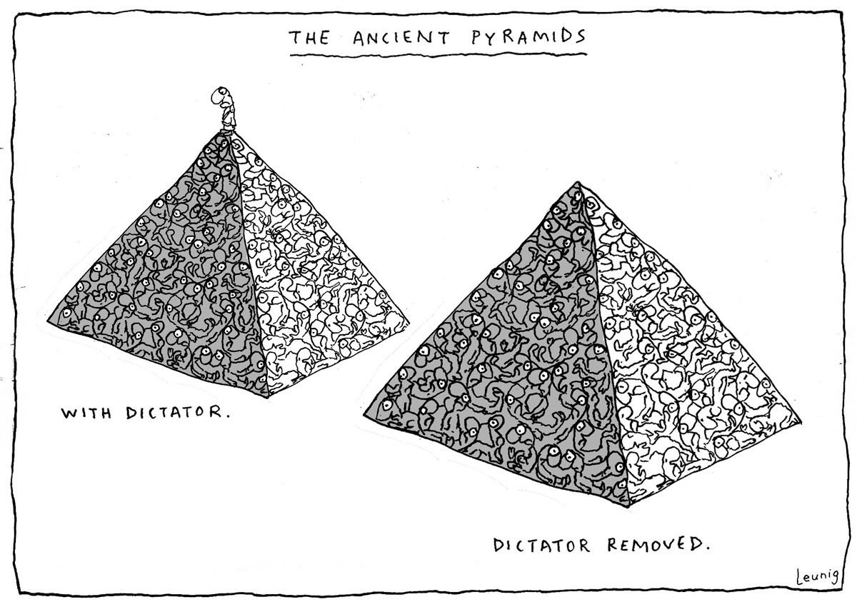
Notes:
Billions worldwide agreed that, by this point in human civilization, they would have expected a better process than entrusting all their political, commercial, and social decisions to vindictive, self-absorbed fuckers.

Slide 13

3: Thick, thin: understanding of context and motives
Notes:
Cat

Slide 14
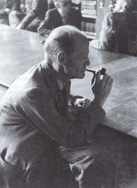
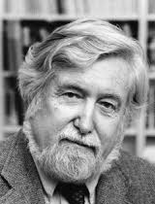
Thick and thin
Gilbert Ryle
Clifford Geertz

Slide 15
Thin to thick
From what to why

Slide 16
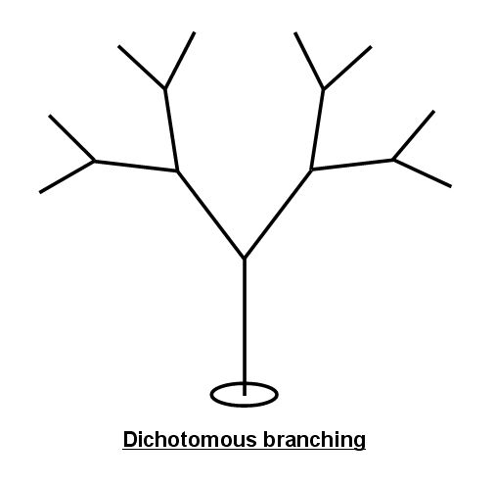
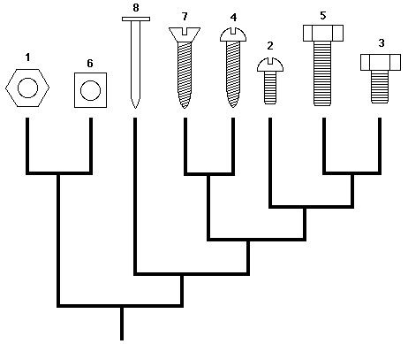
Thin problems are mechanical

Slide 17
Thin policy delivery
Top-down policy can work
  Tax and family benefits changes
  Student loans
  Child Support Agency
  Stroke of the pen deregulation
    shopping hours, two airline policy

Slide 18
Thick policy delivery
  Regulation
  IT
  Education
  Health
  Defence
  Transport
  Employment services
  Social support (Indigenous and other)

Slide 19
Ideologies are thin, issues are thick
Income management
User Choice
Diversity
Core values
Individual responsibility
Collective responsibility

Slide 20
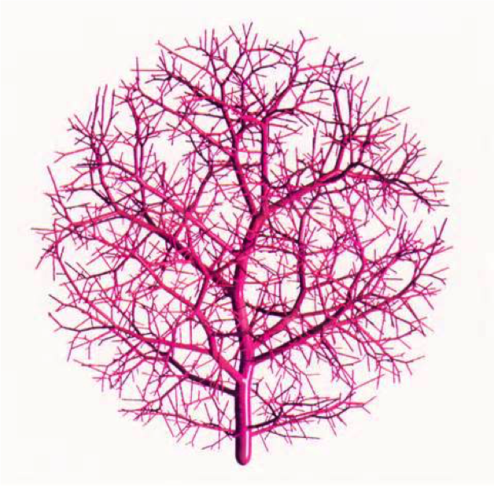
Arteries, capillaries and status
If there were a single cultural predilection in the APS I'd change, it would be the unspoken belief that the development of government policy is a higher function – more prestigious, more influential, more exciting –than delivering results.
Peter Shergold, 2005.
This disposition to admire, and almost to worship, the rich and the powerful, though necessary to maintain the order of society, is, at the same time, the most universal cause of corruption of our moral sentiments.
Adam Smith, 1759
The ambitious know full well that the road to the top is through policy, generating ideas, managing the blame game, being visible in Ottawa circles, and central agencies, not through program management.
Donald J. Savoie “What Is Government Good At? A Canadian Answer” 2015

Slide 21
Policy
Learning goes upward =>
Delivery

Slide 22
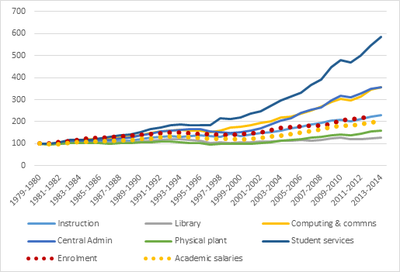
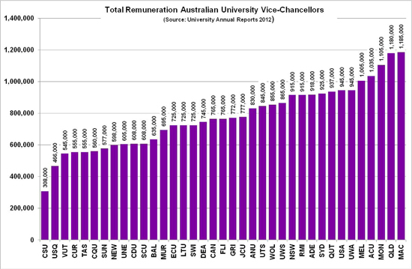
Academia
Notes:
http://higheredstrategy.com/category/administration/page/2/
True in business
True in Policy

Slide 23
The arteries are willing, but the capillaries are weak

Slide 24
NSW Audit Office on Reg Review
Regulatory burden increased
Over the life of the ‘one-on, two-off’ initiative overall net legislative regulatory burden increased by $16.1 million.
The numeric test was met with 237 instruments repealed and 54 introduced — an overall ratio of roughly four repeals for every new instrument. However, most of these repeals related to redundant legislation with little or no regulatory burden.
Legislative complexity increased
The stock of legislative regulation increased.
By 1.4% per year compared with 1.1% falls previously.

Slide 25
IT
Endless policy cycles and revisions accrue.
Subs to Ministers, private office communications, correspondence across departments and occasional harvesting of consultation feedback.
Rarely … does user need get a look-in except internal users.
How the departmental needs can so often trump the needs of public users is beyond me.
Mike Bracken, The strategy is delivery, UK
Notes:
http://mikebracken.com/blog/the-strategy-is-delivery-again/

Slide 26
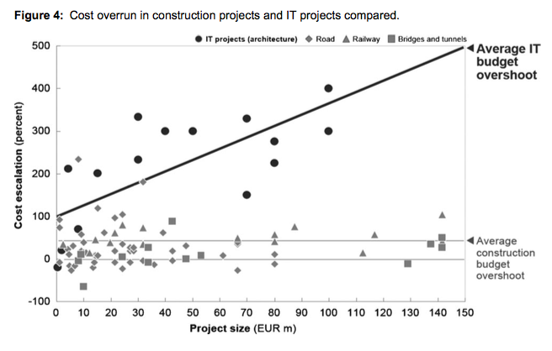
Notes:
Bent Flyvbjerg, 2009, “Survival of the unfittest: why the worst infrastructure gets built—and what we can do about it”, Oxford Review of Economic Policy, Volume 25, Number 3, 2009, pp.344–367

Slide 27
Schools
Cost of divergence between Australia and Canada according to the HALE index of wellbeing is
$17 bil of human capital each year

Slide 28
Health: micro-detail as a thicket
In our report, you can read how hospitals are required to sign up to IP restrictions preventing data transfer between wards.
Or how cancer researchers use foreign data sets because local ones are more restricted.
Or how a nationally-funded research project into vaccination is nearly 7 years into a saga to be allowed access to Commonwealth and States’ data sets. It expects to be finally allowed full access in another year or so.
These are pretty disgraceful events.
They are the tip of the iceberg.
Peter Harris, Chairman, Productivity Commission, 2017

Slide 29
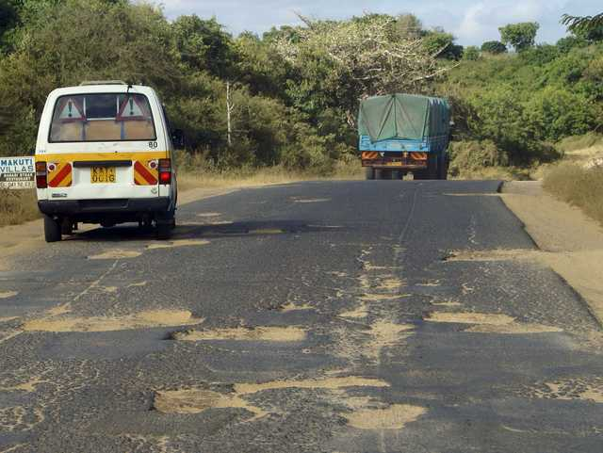
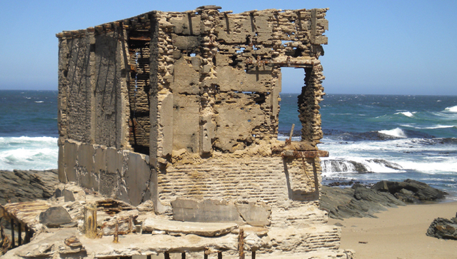
The cult of announceables
Notes:
CAT

Slide 30
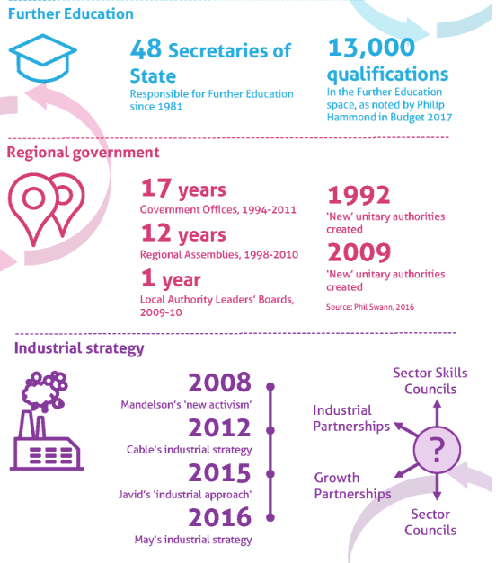
Notes:
Institute for Government, All change, 2017
https://www.instituteforgovernment.org.uk/our-work/better-policy-making/all-change

Slide 31
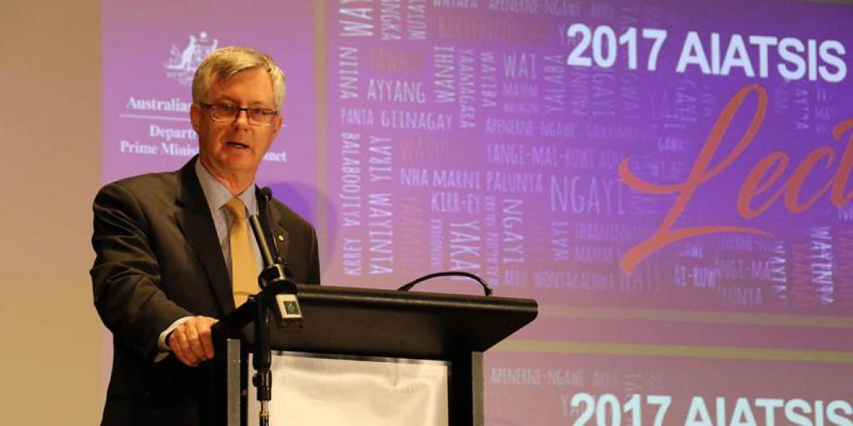
In 50 years, Commonwealth administration of Indigenous Affairs has cycled through 21 different ministers, and 11 different structures under them.
Ten of the 11 structures have occurred in the last 30 years.
Notes:
https://www.themandarin.com.au/84320-martin-parkinson-promise-1967-commonwealth-public-administration-indigenous-affairs-50-years/

Slide 32
4 Evidence based programs

Slide 33
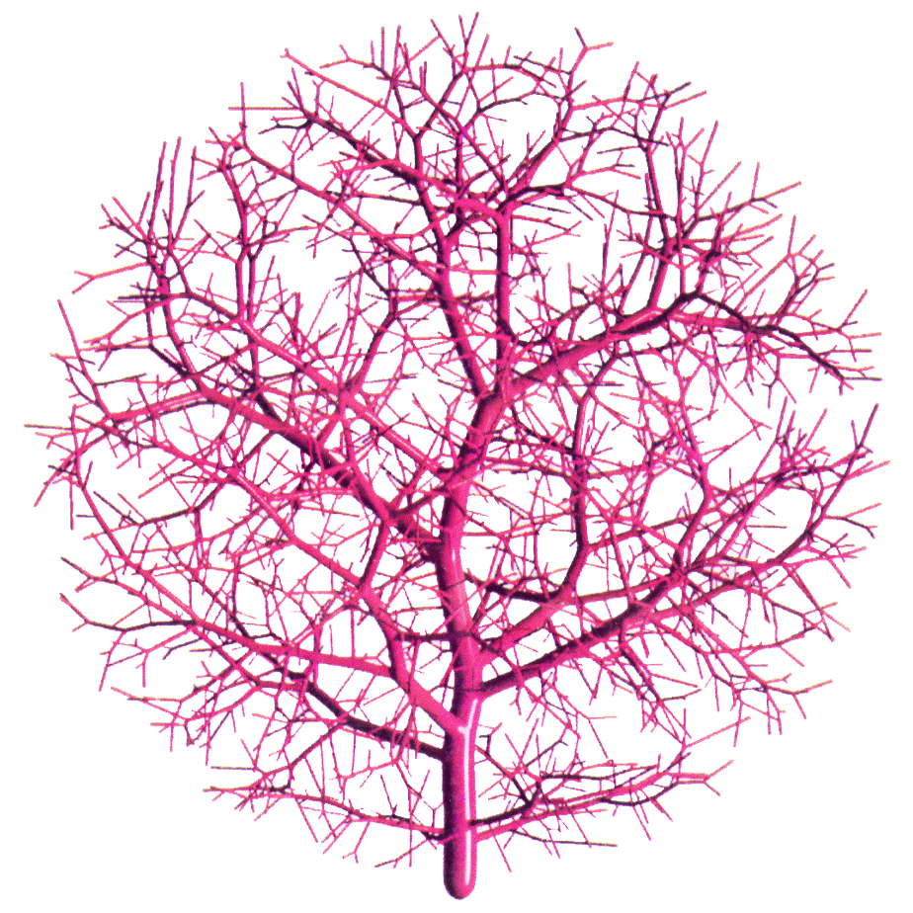
Evidence based delivery
Policy
Delivery

Slide 34
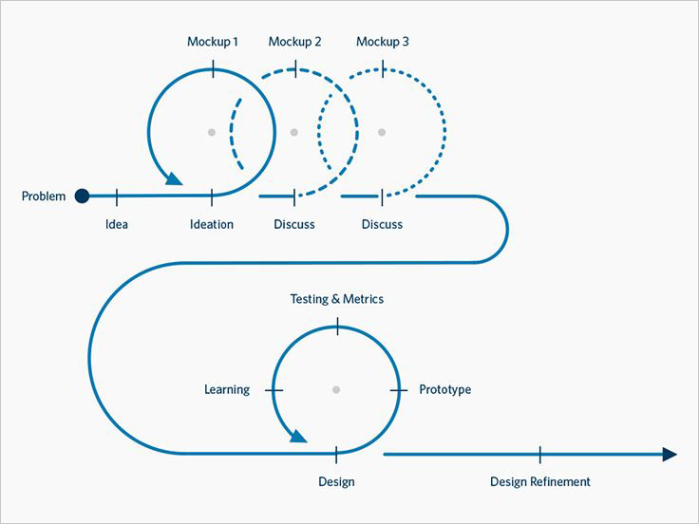
Design: evidence based delivery

Slide 35

Empathic bond

Slide 36
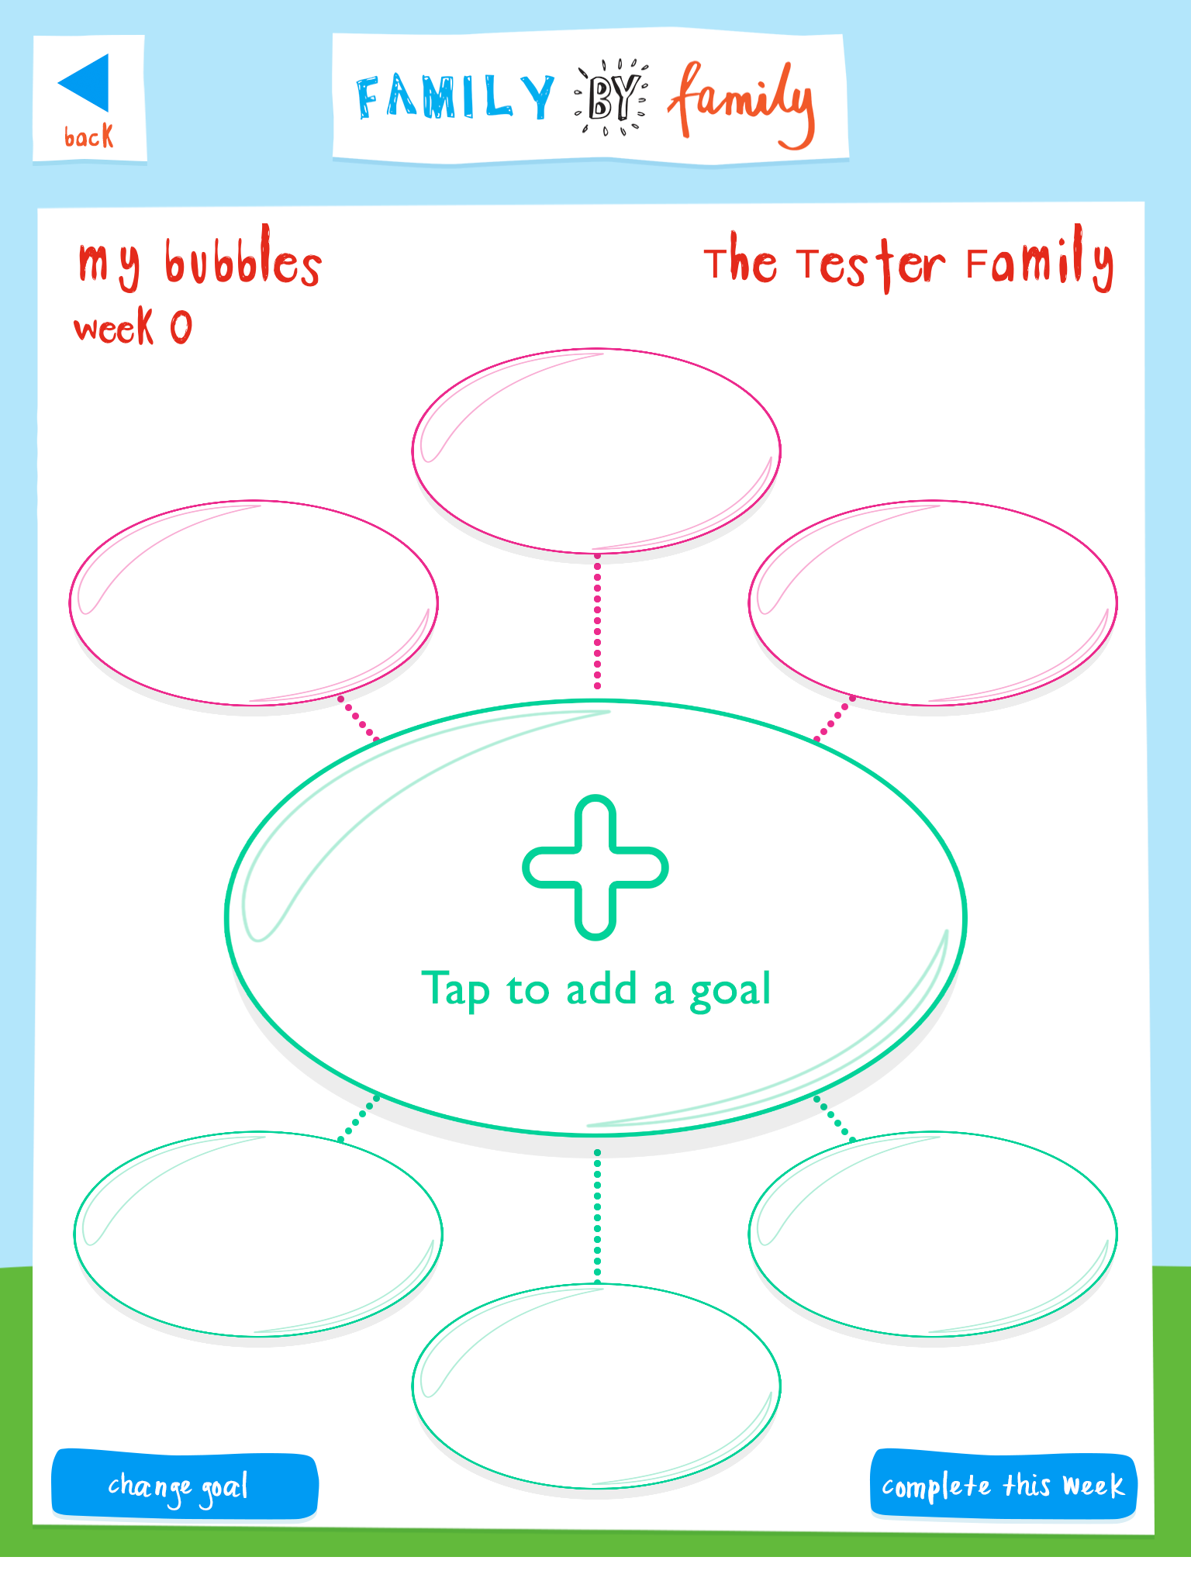
I’ve worked with that family for 3 years and I just learnt more about them in 2 hours.
Case worker
Families commented: “you’re the only one who has ever asked what would work for my family”.
Family coach

Slide 37

Notes:
Insert: 4 Family by Family Stories No CC.mp4

Slide 39
5 What evidence?

Slide 40
Program efficacy depends on causality
Generalisability:
  It works somewhere – from an impact evaluation
  It works in general – from synthesis of a range of impact evaluations
  It will work for us – is a question of judgement; the potential that it will work for us depends on the context in which it is implemented and the quality of implementation.
Family by Family – 6 week scoping in new suburbs
  To optimise efficacy and
  Test for validity
Notes:
It is not uncommon for decision-makers to leap from ‘it works somewhere’ to ‘it will work for us’. Then being disappointed when the program performs badly due to differences in context or implementation. [Nancy Cartwright work on causal claims]

Slide 41
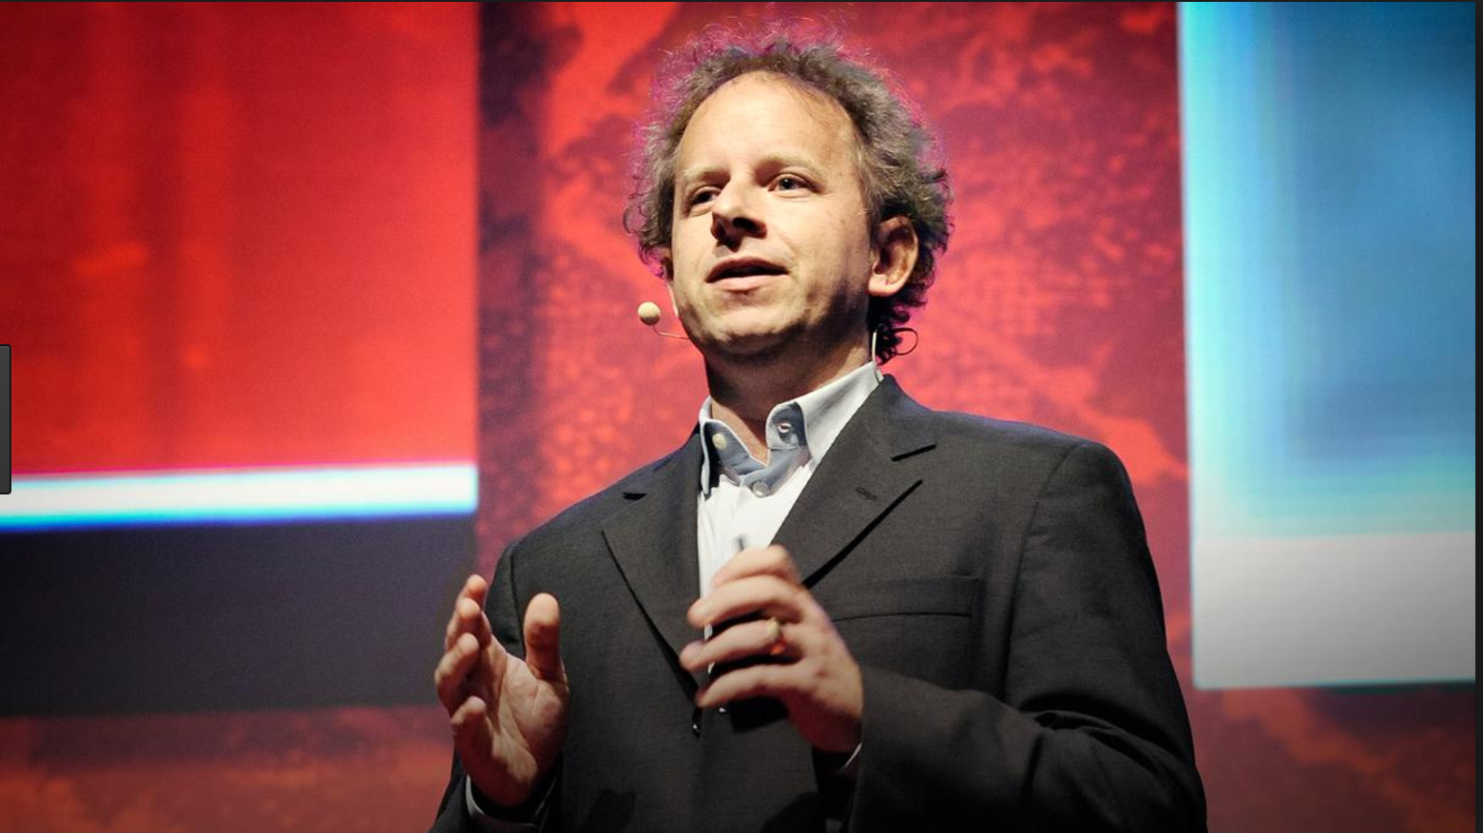
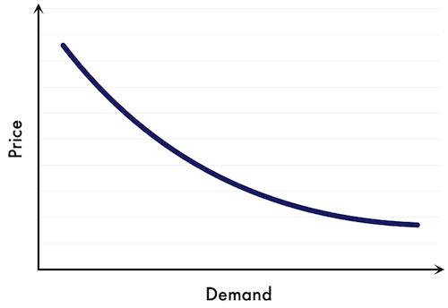
What kind of data do we need?

Slide 42
Data on what causes what
“Our success at Amazon is a function of how many experiments we do per year, per month, per week, per day….”
Jeff Bezos
“Last year at Google the search team ran about 6,000 experiments and implemented around 500 improvements based on those experiments. The ad side of the business did about the same. Any time you use Google, you are in many treatment and control groups. The learning from those experiments is fed back into production and the system continuously improves.”
Hal Varian, chief economist at Google
Notes:
Bezos https://medium.com/abundance-insights/culture-experimentation-with-uber-s-chief-product-officer-520dc22cfcb4
Google quote. Stiglitz et al, “Creating a Learning Society: A New Approach to Growth, Development ……” https://books.google.com.au/books?id=IesYBQAAQBAJ&pg=PA537&lpg=PA537&dq=hal+varian+google+did+over+6000+experiments+last+year&source=bl&ots=rkd_seFtLT&sig=4oKn_rKv0HxRSjM2ulG6kpht0YA&hl=en&sa=X&ved=0ahUKEwjN45zP1dHVAhXFEbwKHT09DfgQ6AEIKDAA#v=onepage&q&f=false
Hal Varian, letter to the Economist. 2011

Slide 43
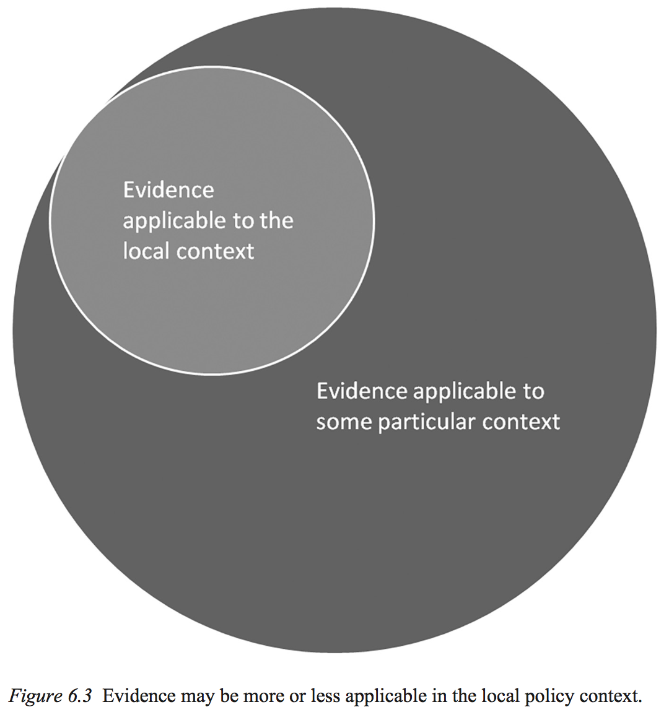
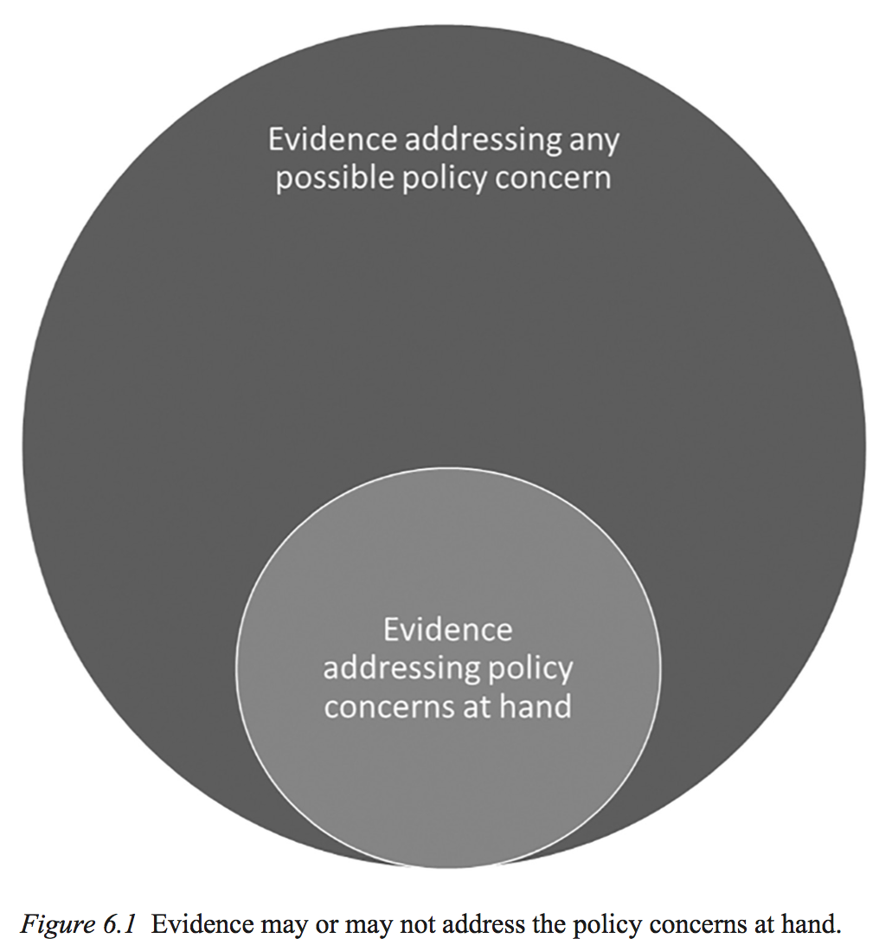

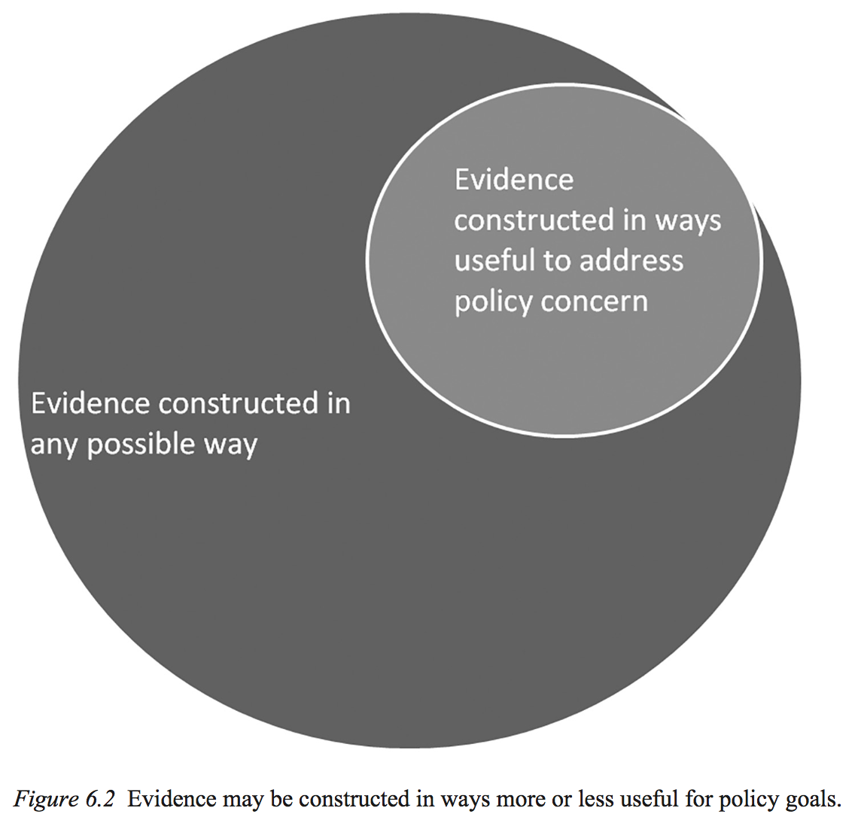
Justin Parkhurst,
The Politics of Evidence: From evidence-based policy to the good governance of evidence
Notes:
The politics of evidence

Slide 44
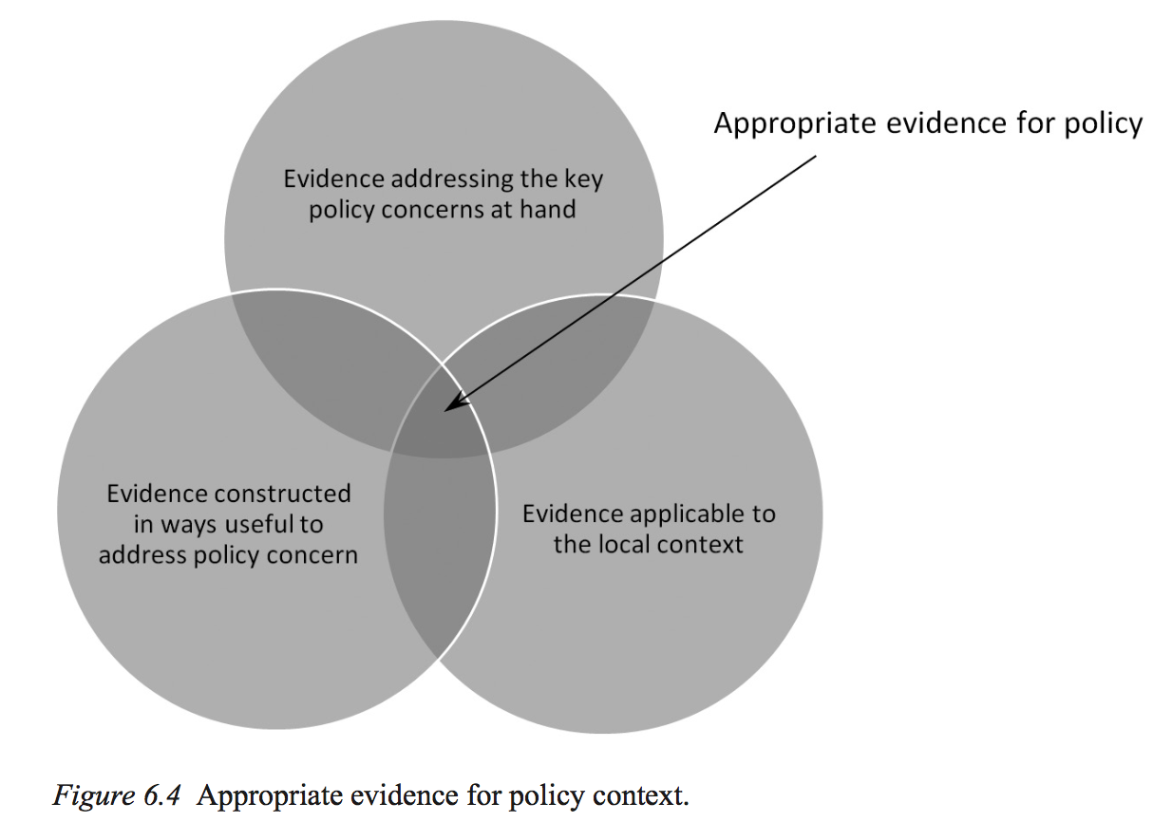
Quality
Political
constraints
Notes:
The politics of evidence

Slide 45
6 Program logic

Slide 46
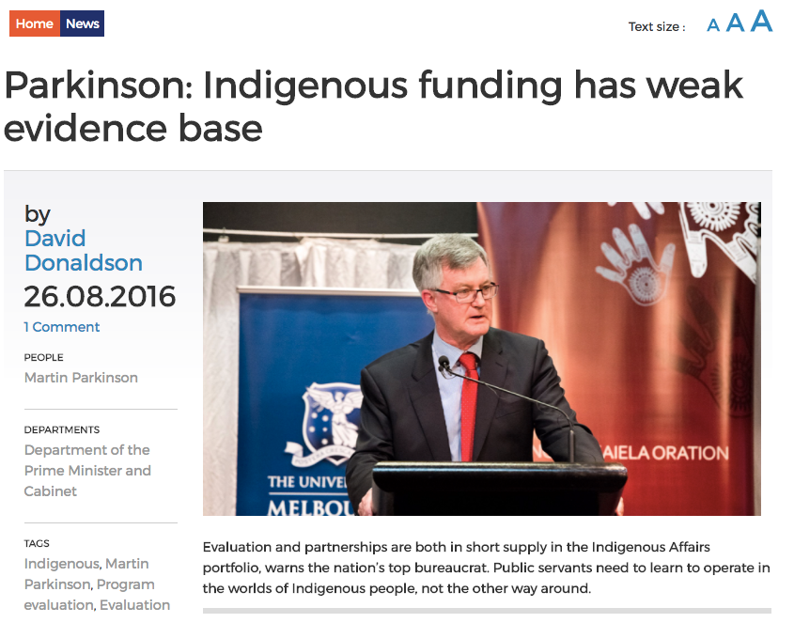
Notes:
Here's the thing
EVERYTHING has a weak evidence base
Yet Department Finance is the Government's CFO

Slide 47
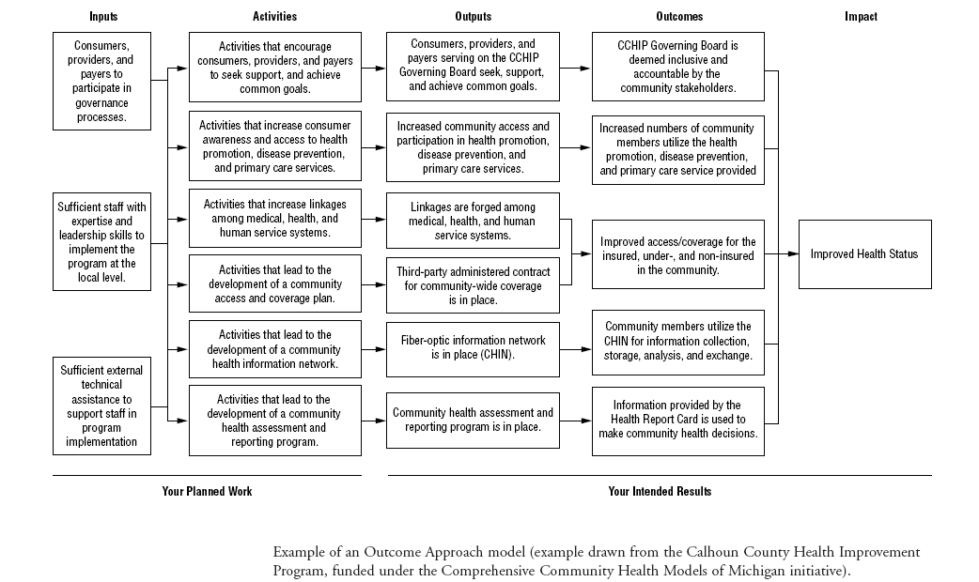

Slide 48
Program Logic
Notes:
Program theory focuses attention on the causal logic within a program

Slide 49
One of the main conceptual holdovers from the world of evidence-based medicine has been the widespread, and often uncritical, embrace of so-called ‘hierarchies’ of evidence
Justin Parkhurst, The Politics of Evidence: From evidence-based policy to the good governance of evidence 2017
Notes:
The Politics of Evidence
From evidence-based policy to the good governance of evidence
Justin Parkhurst
2017 Routledge, p. 108

Slide 50
RCTs are one of many tools
Angus Deaton
William Easterly
Dani Rodrik
Sanjay Reddy
“Randomization is a metaphor and not a gold standard,” James Heckman
And “Student’s” collaborator, the experimental maltster and barley farmer, Edwin S. Beaven.
Notes:
The politics of evidence

Slide 51
RCTs can be important but they’re thin

Slide 52
Hayek on scientism: 1942
In the hundred and twenty years or so during which this ambition to imitate Science in its methods rather than its spirit has now dominated social studies, it has contributed scarcely anything to our understanding of social phenomena…
Demands for further attempts in this direction are still presented to us as the latest revolutionary innovations which, if adopted, will secure rapid undreamed of progress.

Slide 53
Program Logic
Randomised Controlled Trial

Slide 54
Deaton and Cartwright on RCTs
RCTs are valuable. Yet some enthusiasm for them seems based on misunderstandings. That:
randomization allows a precise estimate of the treatment alone;
that randomization is required to solve selection problems;
lack of blinding does little to compromise inference; and
statistical inference in RCTs is straightforward, because it requires only the comparison of two means.
None of these statements is true.
RCTs require minimal assumptions and little prior knowledge, an advantage when persuading distrustful audiences, but disadvantage for scientific progress.
The lack of connection between RCTs and other scientific knowledge makes it hard to use them outside of the exact context in which they are conducted.
They can play a role in building knowledge, provided they are combined with other methods, to discover not “what works,” but why things work.
RCT McNuggets: RCTs as scientistic trinkets

Slide 55
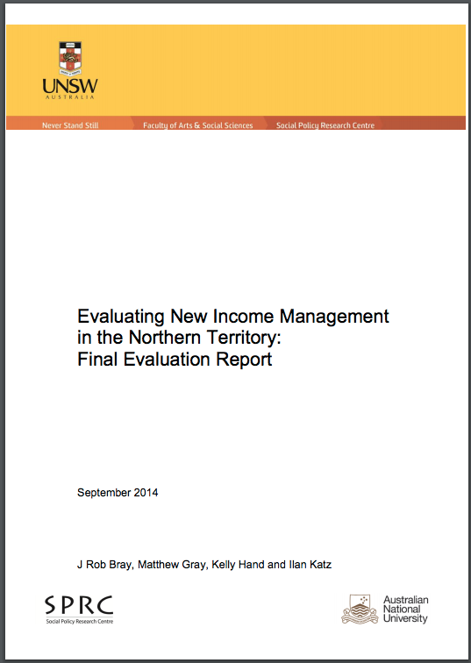
A very small part of evidence based policy …

Slide 56
Data on what causes what
“Our success at Amazon is a function of how many experiments we do per year, per month, per week, per day….”
Jeff Bezos
“Last year at Google the search team ran about 6,000 experiments and implemented around 500 improvements based on those experiments. The ad side of the business did about the same. Any time you use Google, you are in many treatment and control groups. The learning from those experiments is fed back into production and the system continuously improves.”
Hal Varian, chief economist at Google
Notes:
Bezos https://medium.com/abundance-insights/culture-experimentation-with-uber-s-chief-product-officer-520dc22cfcb4
Google quote. Stiglitz et al, “Creating a Learning Society: A New Approach to Growth, Development ……” https://books.google.com.au/books?id=IesYBQAAQBAJ&pg=PA537&lpg=PA537&dq=hal+varian+google+did+over+6000+experiments+last+year&source=bl&ots=rkd_seFtLT&sig=4oKn_rKv0HxRSjM2ulG6kpht0YA&hl=en&sa=X&ved=0ahUKEwjN45zP1dHVAhXFEbwKHT09DfgQ6AEIKDAA#v=onepage&q&f=false
Hal Varian, letter to the Economist. 2011

Slide 57
Evidence based policy
Policy
Delivery
Notes:
Trying to figure out what was stopping Family by Family growing and what could be done about it.

Slide 59
Evidence based Policy: Good things to have
Expertise
  To understand difficulties and maximise the chance to learn
Built round the practical needs of field workers to improve
Causal data (A/B testing)
  To help us learn and improve
Openness
  To build a community of practice and collaborative problem solving
Independence
  To keep us honest, externally, internally, up, down
Incentive compatibility
  To keep us trying
Evaluation planned and built in. Not retrospective and bolt on
  So it’s efficacious

Slide 60
Policy
Learning goes upward =>
Delivery

Slide 61
8 Institutionalising evidence-based policy

Slide 62

Continual testing against the facts of the life world

Slide 63
Expertise, collaboration
independence

Slide 64

The institutional imperative

Slide 65
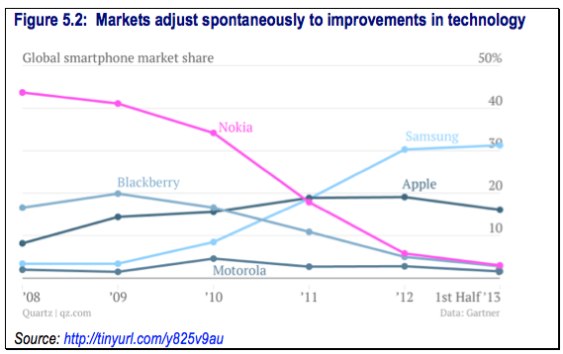

Slide 66
Too much innovation remains at the margin of public administration. Opportunities are only half-seized; new modes of service delivery begin and end their working lives as ‘demonstration projects’ or ‘pilots’; and creative solutions become progressively undermined by risk aversion and a plethora of bureaucratic guidelines.
Peter Shergold, 2013.

Slide 68




Within Portfolio Effects (Funded)
Child Protection
Within Portfolio
Effects
(Unfunded)
DV
Private
Benefit
Wages
SWB
Intervention
Builds Social
Capital
Extra Portfolio Effects
Education
Health
Mental health
Housing
Corrections
Tax Revenue
Social
Benefit
Healthier
Happier
Safer
More resilient
places and communities

Slide 69
Business-as-usual
Expertise, collaboration
independence
Expertise, collaboration
independence

Slide 70
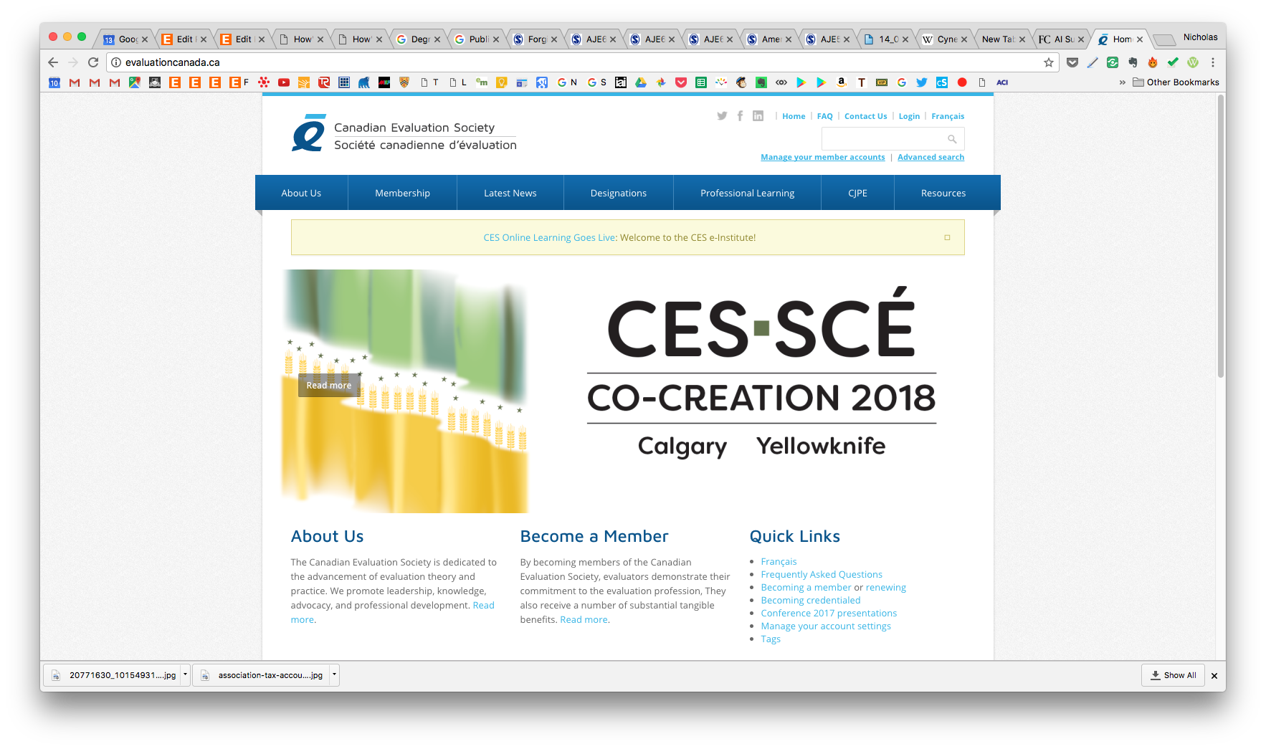
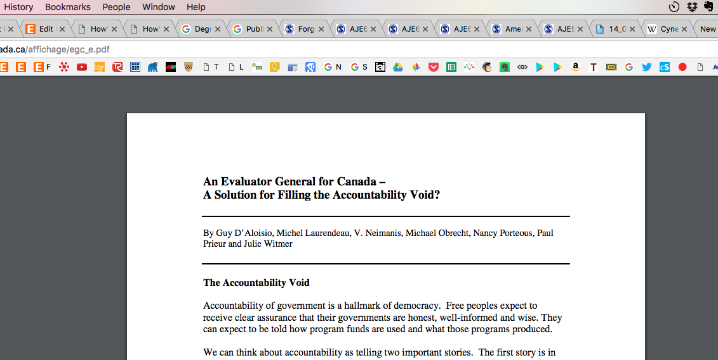
Notes:
http://evaluationcanada.ca/affichage/egc_e.pdf

Slide 71
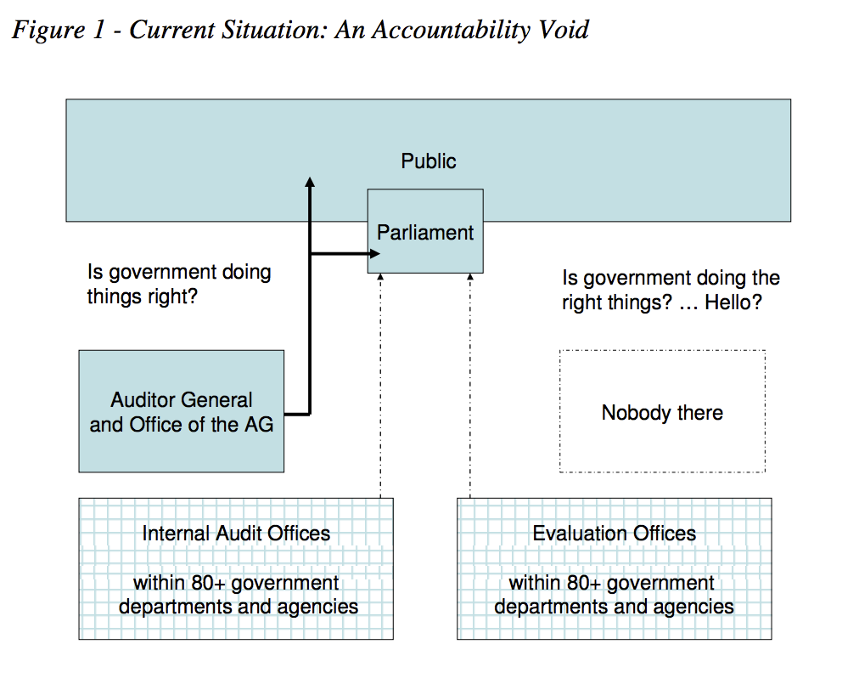
Notes:
http://evaluationcanada.ca/affichage/egc_e.pdf

Slide 72
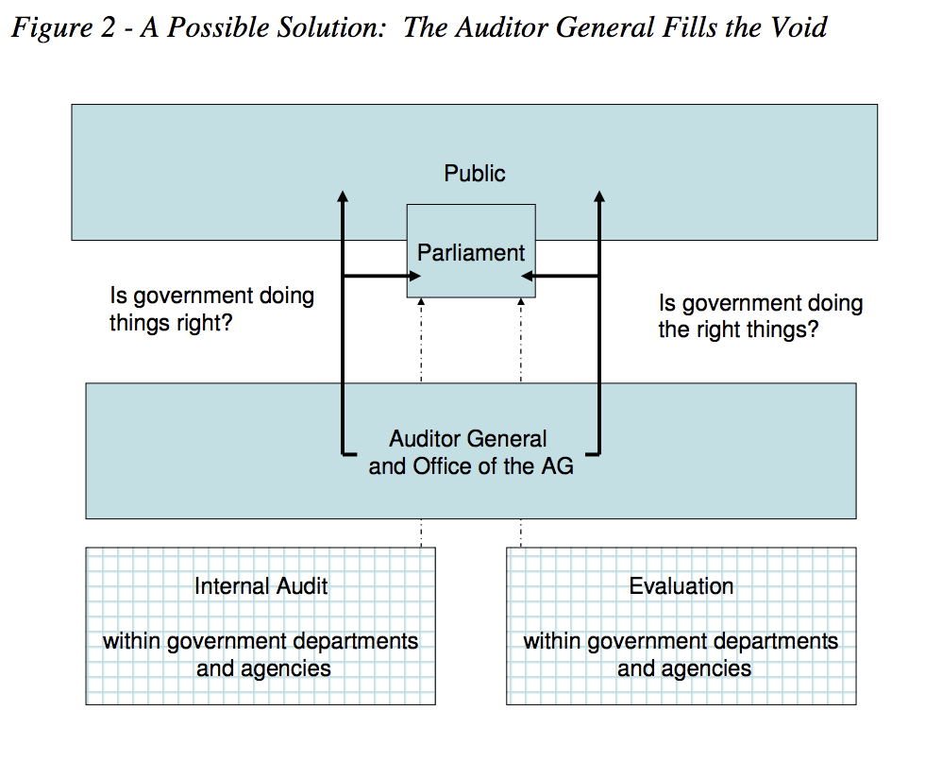
Notes:
http://evaluationcanada.ca/affichage/egc_e.pdf

Slide 73
But it would be a mistake to expect that one person, the Auditor General, would be able to function in both paradigms simultaneously, just as it would be erroneous to imagine that an audit official grounded in chartered accountancy could work effectively in the area of effectiveness assessment where no absolute bottom line can ever be reckoned.

Slide 74
Business-as-usual
Evaluator General
Expertise, collaboration, independence

Slide 75
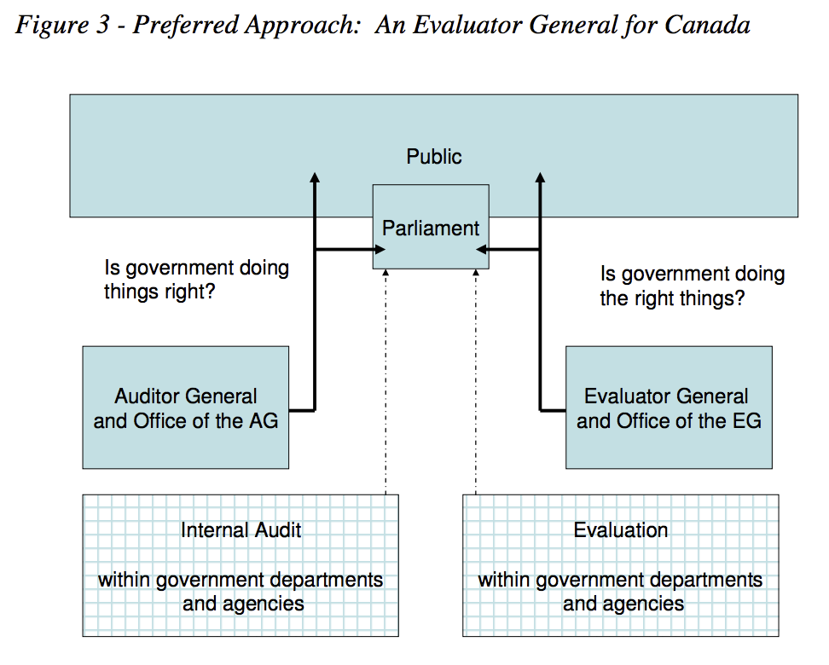
Notes:
http://evaluationcanada.ca/affichage/egc_e.pdf

Slide 76
Two systems
Competitive
provision
  Delivering services
    Departments of state
  Making choices
Direct provision
  Integrity
    Auditor Gen’l, Ombsmn
  Information
  Knowing what we’re doing
  Understanding policy choices
    PC
    PBO

Slide 77
Accountability
It is not necessary to abandon the notion or being accountable for what has to be done done but to return to the meaning and focus on systems of accountability that both justify [it can be justified] and explain what has been done. This requires careful consideration of who is being held accountable, to whom, for what, how, and with what consequences.
More thoughtful and comprehensive approaches to accountability should demonstrably support good performance and encourage responsibility.
Patricia Rogers, ANZSOG
Notes:
Mathison, Sandra 2005, Encyclopedia of evaluation, Sage, Thousand Oaks, California
https://books.google.com.au/books?id=0o_fCgAAQBA

Slide 78
Evidence based delivery: Good things to have
Expertise
  To understand difficulties and maximise the chance to learn
Built round the practical needs of field workers to improve
Causal data (A/B testing)
  To help us learn and improve
Openness
  To build a community of practice and collaborative problem solving
Independence
  To keep us honest, externally, internally, up, down
Incentive compatibility
  To keep us trying
Evaluation planned and built in. Not retrospective and bolt on
  So it’s efficacious

Slide 79
Starting out
Grow expertise and independence of evaluation
  Can start very small
    within government agencies
Identify some priority sectors (and/or regions)
  Indigenous policy (Aus)
  Child protection (Aus)
  Loneliness (UK)
  Wellbeing (UK)
Set some system targets with independent reporting on them (from Auditor General)

Slide 80
E ngruen@lateraleconomics.com.au
The end

Slide 81

E ngruen@lateraleconomics.com.au
The end

Slide 83
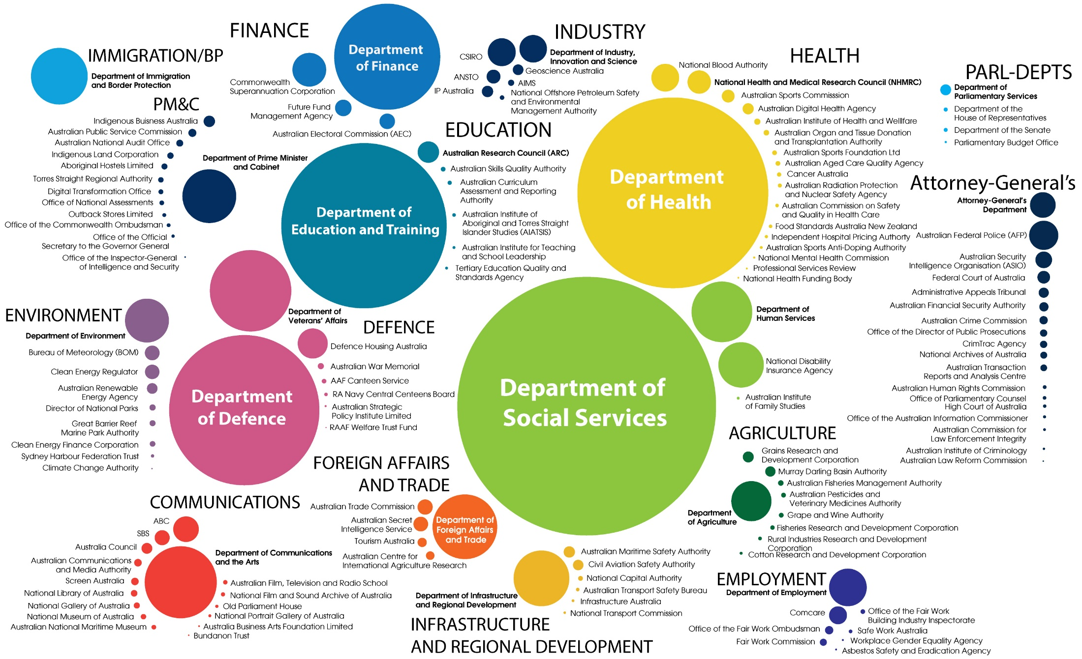
2016–17 Federal Budget—$450.6 billion
Source: Budget Paper No. 4 2016-17
Notes:
Diagram to illustrate proportion of funding allocated in 2016–17 Federal Budget to all Australian departments and agencies. Dollars allocated to agencies are shown by the size of the circles of each department and agency.

Slide 84
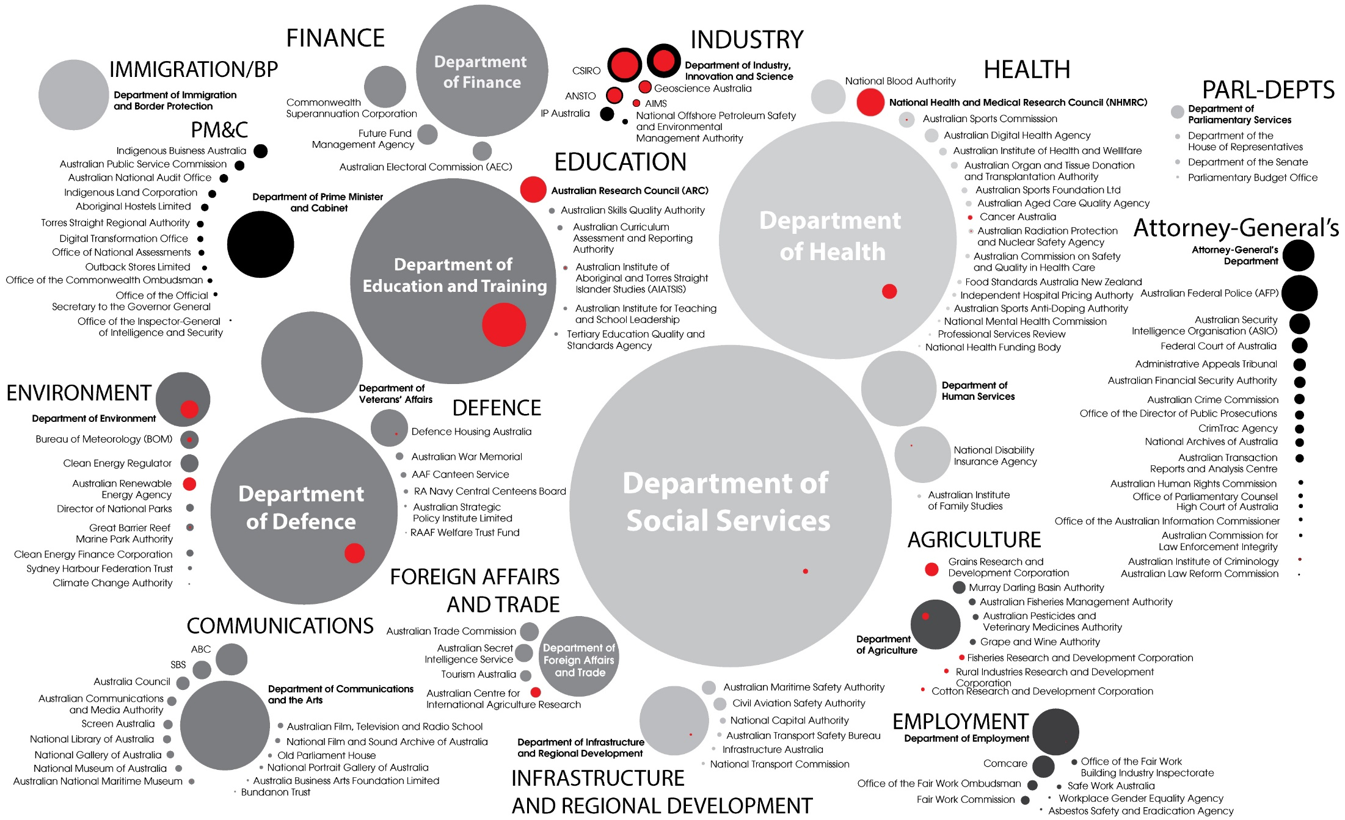
2016–17 Federal Budget—R&D $10.1 billion
Source: Science, Research and Innovation Budget Tables 2016–17
Notes:
Diagram to illustrate proportion of funding allocated in 2016–17 Federal Budget to all Australian departments and agencies. Dollars allocated to agencies are shown by the size of the circles of each department and agency. This graph draws attention to the proportion of R7D allocated funding.

