Slide 1
Enabling inclusion in a digital democracy
Data, tools and platforms: how technology may help or hinder public policy & decision-making

Slide 2
Linked semantic platforms for policy & practice
2yr multi-institute, multi-database ARC LIEF-funded project
To enable public policy research
Step-change to ways of accessing & analysing policy docs & data
Topics include: transport, wellbeing at work, digital inclusion
Develop standard policy taxonomies (search & index terms) & standards
Linking docs & other types of data between data-sets
Mining to access citations in grey literature
Knowledge graphing to enable visualising relationships between entities
APO
Aus Data Archive
AURIN
HomeMods

Slide 3




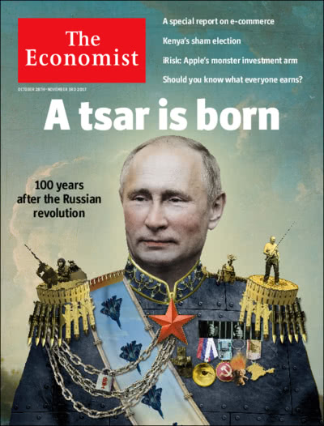




Slide 4
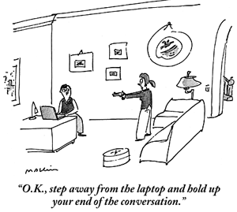
(Next) frontier(s) for APO?
Researchers talking with researchers in same discipline
Researchers talking with researchers in different disciplines
Researchers & ‘interested citizens’ talking
Researchers & others talking

Slide 5

(How) might we take APO into a more public sphere….?
Make debate great again!

Slide 6
Partner with other platforms & organisations?

Slide 7
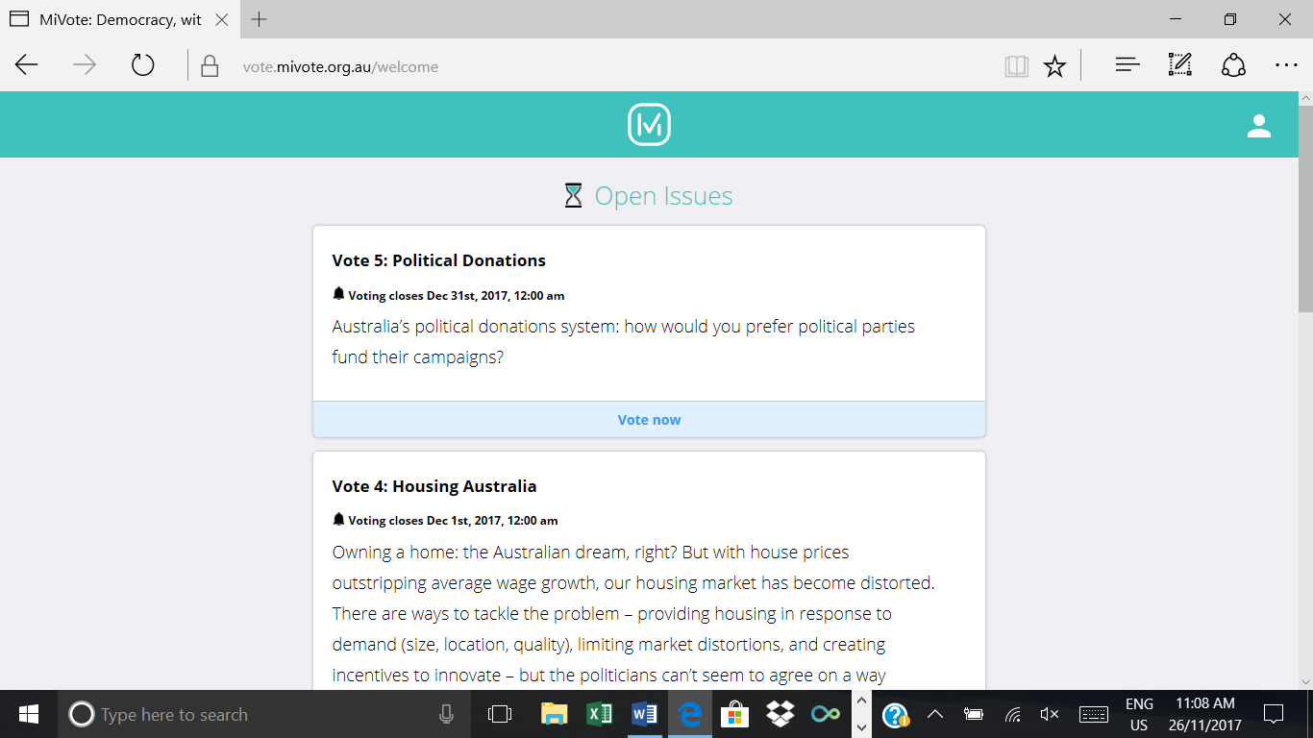
MiVote
There are over 24 million things required for true democracy to exist in Australia.
Your voice is one of them.
You choose the issue
They tell you facts
You vote

Slide 8
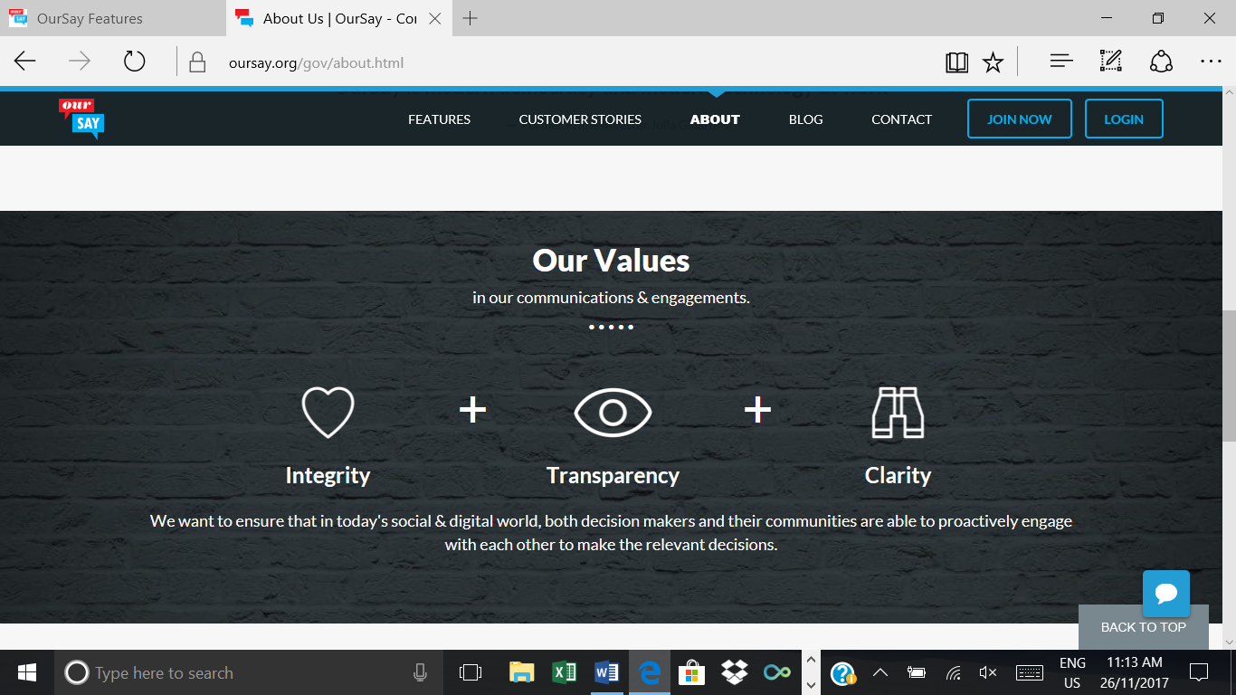
OurSay
Online Engagement
for decisions that matter.
Reach more people, hold conversations, gather insights,
make decisions. Quickly and effectively.
Hired by decision-makers
Give facts
Community gives feed
Decision-makers use that information

Slide 9

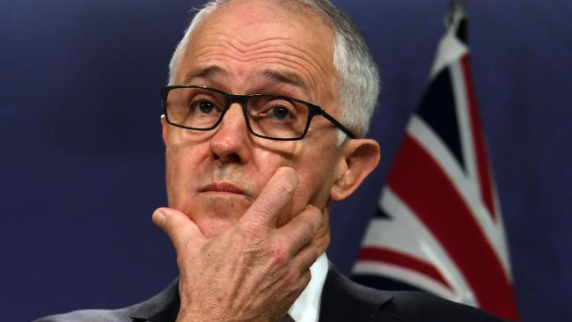
The challenge is to make meaty info more accessible by tapping into existing interests & media use?
Like a meaty Herald Sun…..
Lets Talk Climate Change : Turnbull stresses the importance of weighing up different solutions

Slide 10
How might this happen?

Slide 11
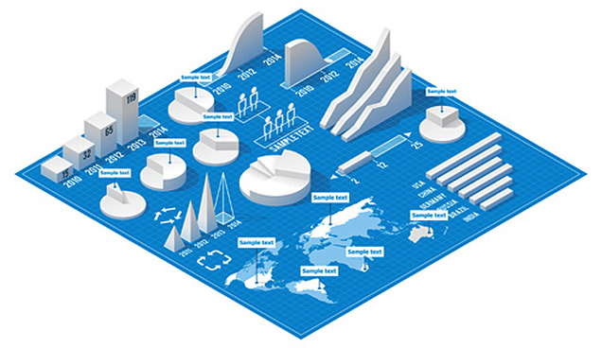

Slide 12
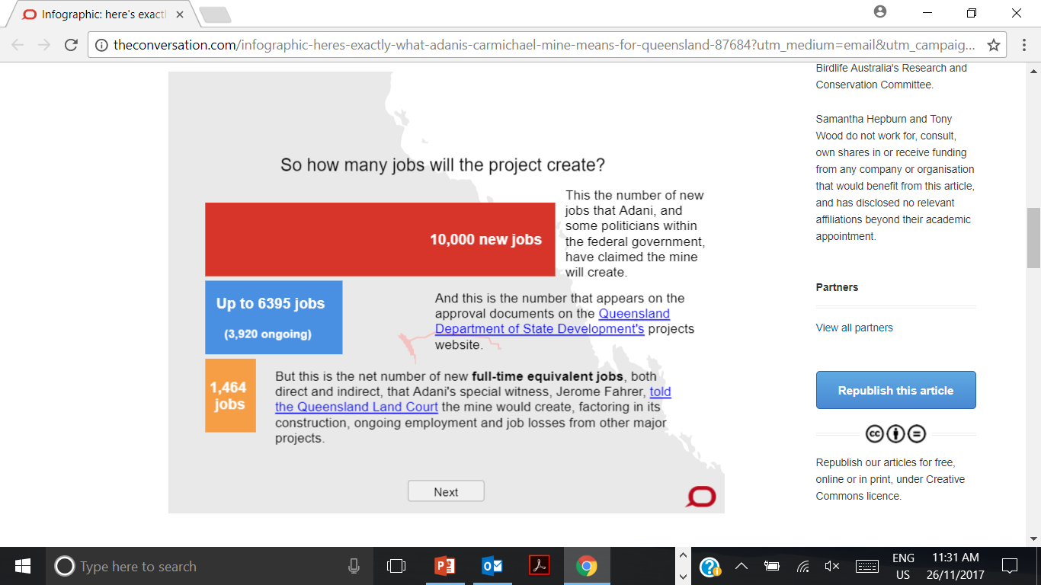
What Adani means for Queensland.
Infographic: here's exactly what Adani's Carmichael mine means for Queensland
Michael Hopkin, The Conversation; Madeleine De Gabriele, The Conversation; Wes Mountain, The Conversation 24/11/2017
One of the biggest issues in this Saturday's Queensland election is the controversial Carmichael coal mine. Our infographic breaks down what it means for Queensland, Australia and the world.

Slide 13

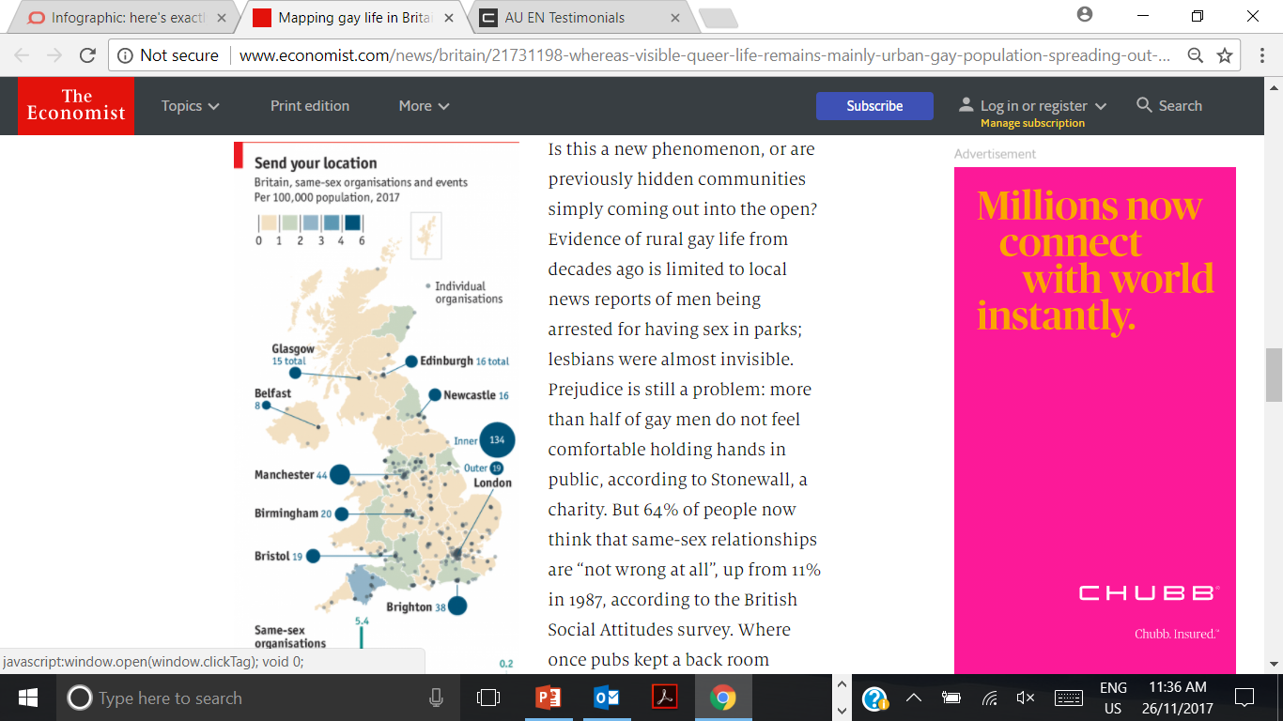
Out and about
Mapping gay life in Britain
For a sense of where queer life is most visible, we scraped listings websites for the details of gay and lesbian organisations. These included everything from charities and church groups to social clubs and saunas.
12/11/2017

Slide 14
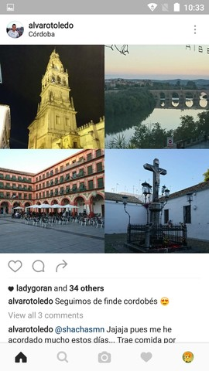
InstAPO

Slide 15
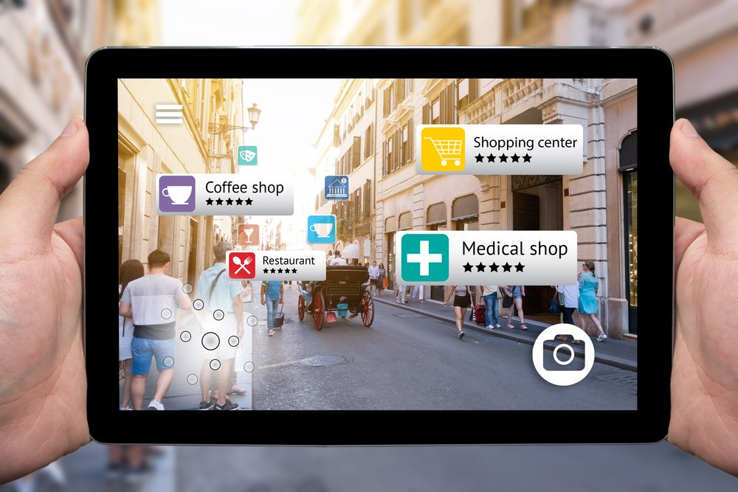
VRAPO

Slide 16
Conclusion
APO already achieves excellence [5th important repository in Aus & 141 in World]
Coupled with AURIN, ADA & others -> more excellence
One next vision is to take APO into spaces end-users are already using & to experiment with new end-user engagement spaces

